Slide 1
Fraud Detection of Transactions.
Arjun Ghadi
BIA – Virar Campus, Mumbai.

Slide 2
Agenda
Introduction
Problem Statement
Goal
Understanding the Dataset
Exploratory Data Analysis
Feature Engineering
Model Selection
Model Performance Evaluation
Model Interpretation and Insights
Final Conclusion

Slide 3

Introduction
Online payments have transformed financial transactions but have also led to an increase in fraudulent activities. Early detection of fraud can prevent significant financial and reputational activities. Early detection of Fraudulent transactions promptly is critical to safeguard users and businesses. Machine Learning(ML) offers a
data-driven approach to identify fraudulent
patterns effectively.
This project leverages machine learning to
build a model for fraud detection.

Slide 4

Problem Statement
Fraudulent transactions are rare but impactful requiring high sensitivity in detection.
Manual review is infeasible due to the volume of transactions
In the banking industry, fraud detection is not only a trend but a necessity for them to put proactive monitoring and fraud prevention mechanisms in place
In this project we will detect fraud transactions with the help of Machine Learning models.
We will analyze customer level data that has been
collected and analyze.

Slide 5

Goal
Build and evaluate multiple ML models to classify transactions as Fraud or not Fraud.
Compare models using metrics like accuracy, precision, recall and f1-score.
Compare the performance of 4 algorithm: Random Forest Classifier, Decision Tree Classifier, Logistic Regression and Support Vector Classifier.
Select the best-performing model for Deployment and real world use case.

Slide 6
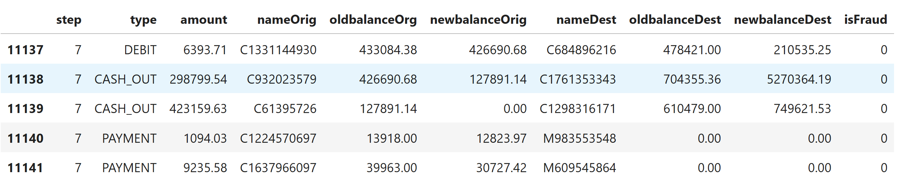
Understanding the Dataset
Fraud Analysis Datasets.
Key Features:
Type: Type of Transactions (eg: Debit, CASH_OUT, PAYMENT, TRANSFER).
Amount: Transaction amount.
Balances before and after the transactions i.e oldbananceOrg and newbalanceOrig.
oldbalanceDest and newbalanceDest:
balances before and after the
transaction for the destination account.
Dataset Shape: Rows: 11142, Columns: 10.

Slide 7
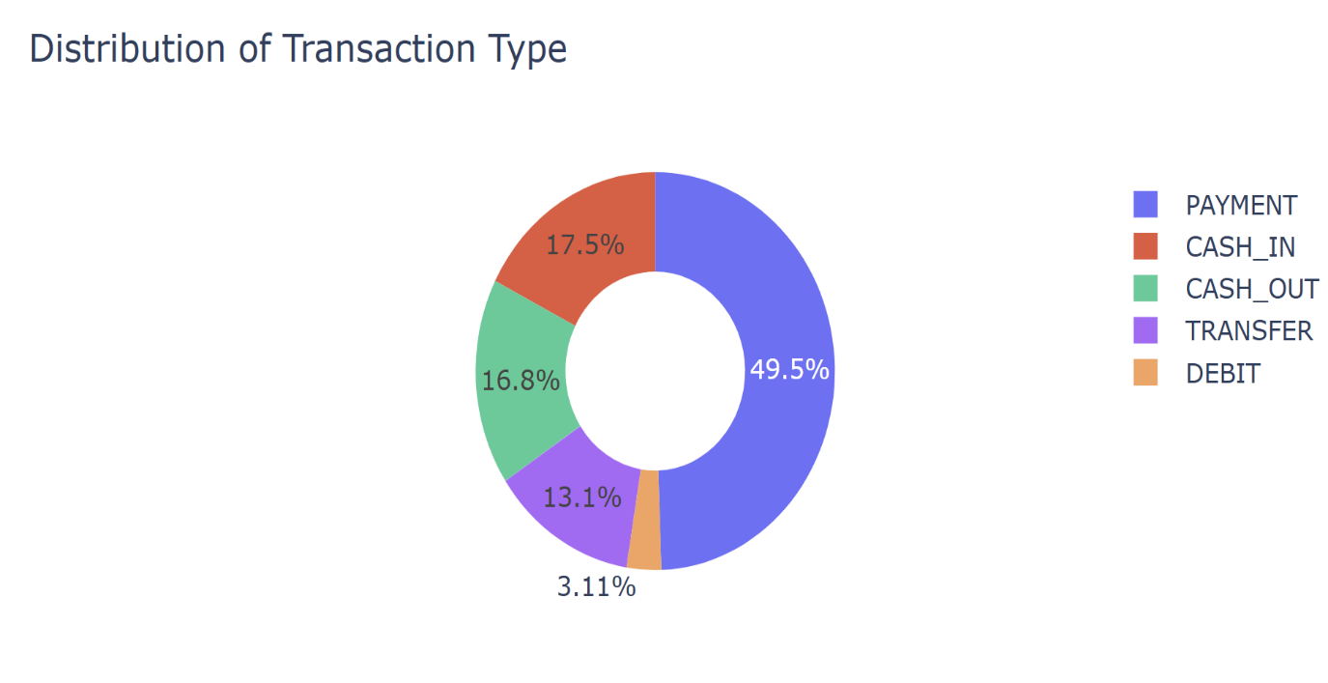
Exploratory Data Analysis.
In this pie chart identifying the Distribution of Transaction Type
In this figure we see that most of the transactions are done through PAYMENT mode.
Followed by the CASH_IN
It means that, there are more transactions taken place by PAYMENT Type are high chance of Fraud.

Slide 8
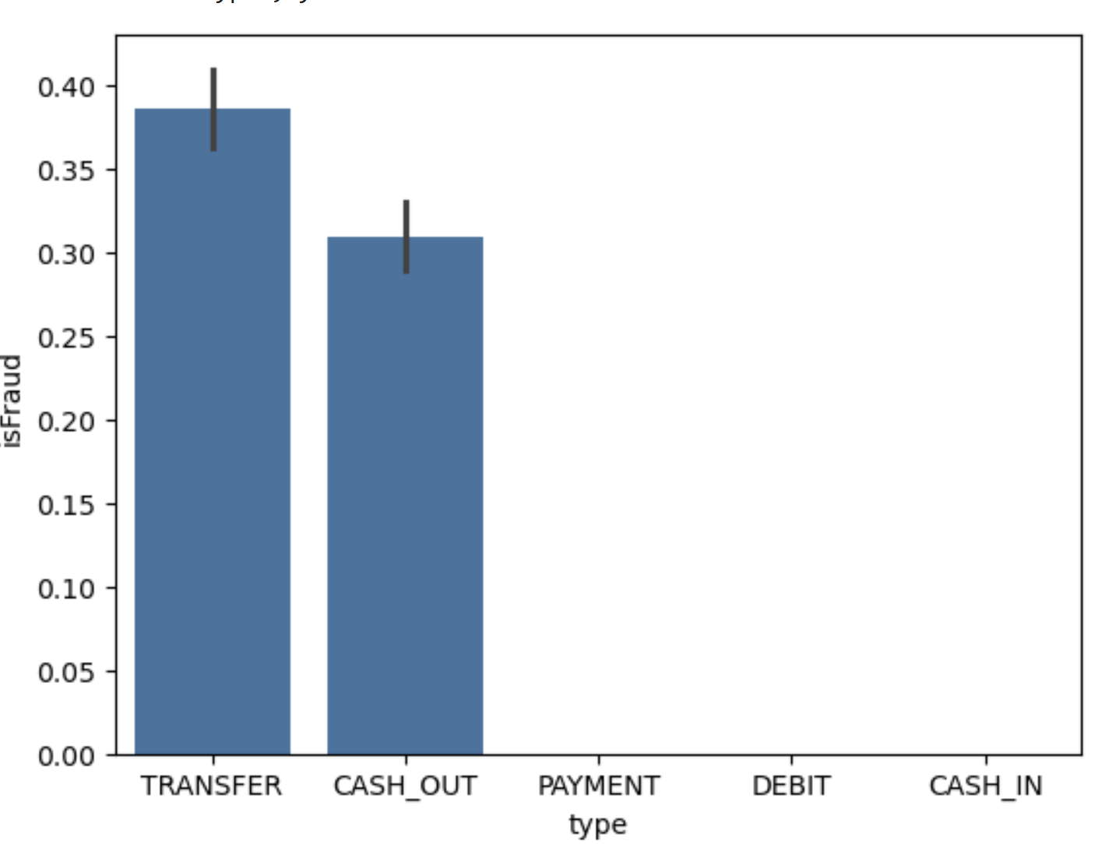
Exploratory data Analysis
This Chart Helps in Highlighting which type of transactions
are more prone to Fraud, helping to identify
patterns and focus areas for the Fraud Detection
Model.

Slide 9
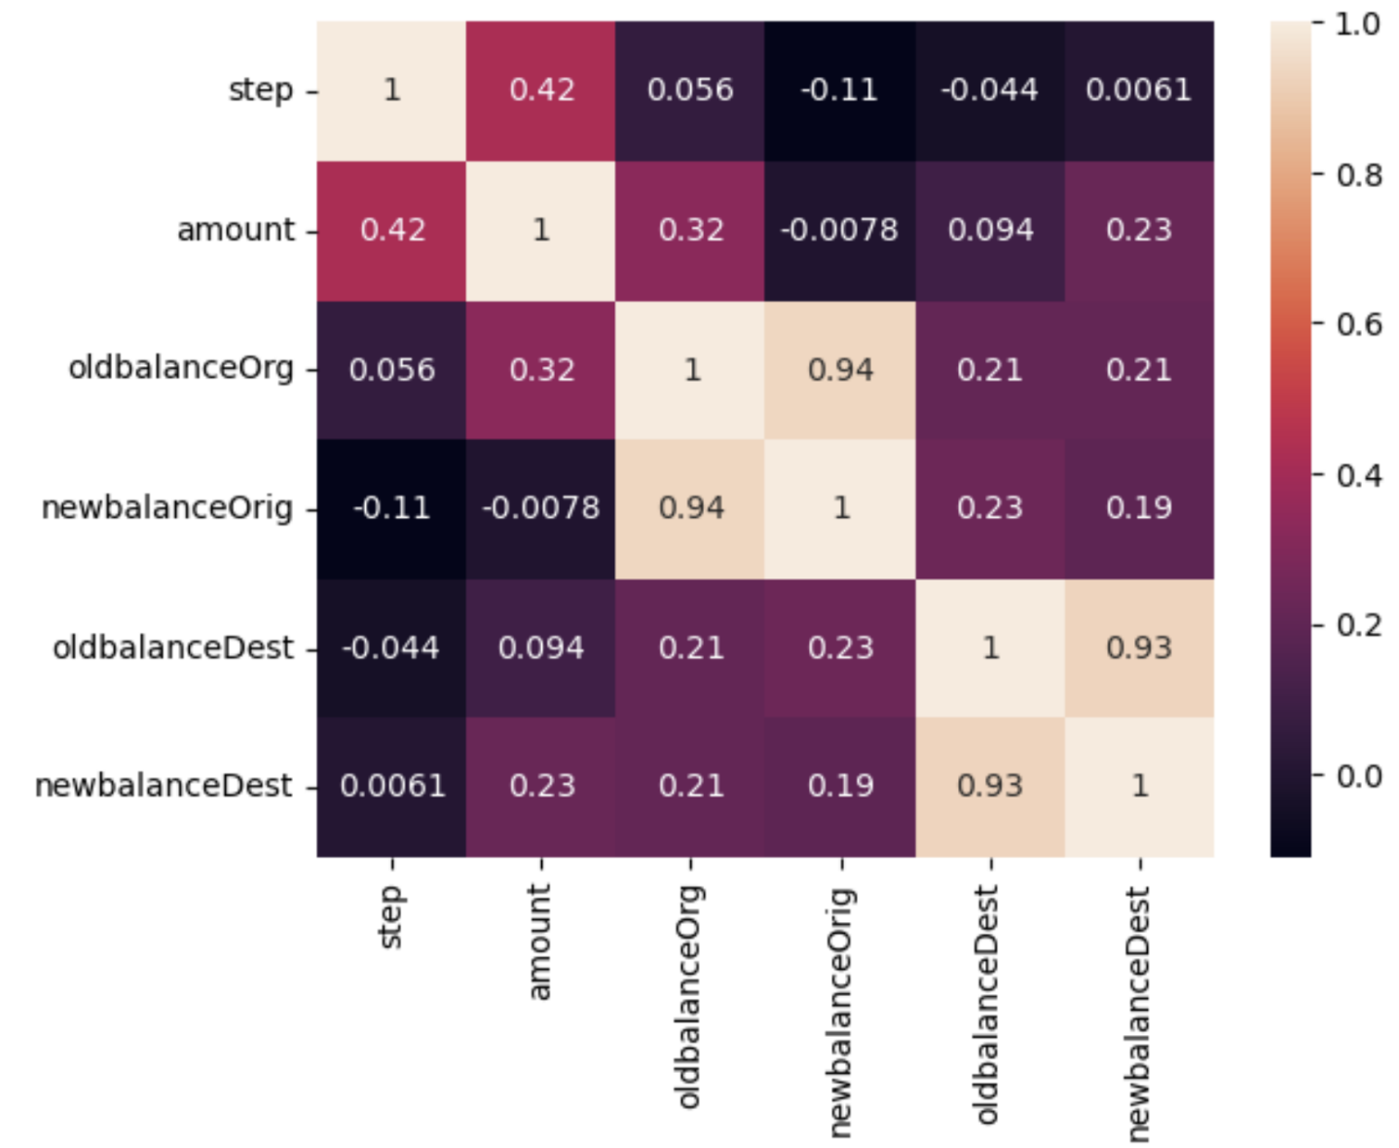
Exploratory Data Analysis.
Correlation heatmap will visually highlight the relationships Between different numeric features, helping to identify strong correlations that could inform feature selection and engineering

Slide 10
Feature Engineering.
Feature engineering is vital for enhancing the performance of our fraud detection model.
It involves identifying and dropping the features, such as 'nameOrig’ and 'nameDest’ which
are unnecessary for model building.
We also encode categorical variables for numerical analysis, and handle missing values to ensure data integrity.
By thoughtfully engineering features, we improve the model’s ability to accurately identify
fraudulent transactions and enhance overall predictive accuracy.
Data has also been split into Train and Test for the evaluation purpose.

Slide 11
Model Selection
We explored various classifiers, including Random Forest Classifier, Decision Tree Classifier, Support Vector Classifier, XGBoost and Logistic Regression. Each algorithm has its strengths; for instance, Logistic Regression is robust to overfitting, while Random Forest Classifier often delivers high accuracy through ensemble learning.
To assess model performance, focused on several key metrics.
Precision: Measures the accuracy of positive predictions (fraudulent transactions).
Recall: Indicates the model’s ability to identify all the actual fraudulent transactions.
F1-Score: The harmonic mean of precision and recall, providing a balance between the two metrics.
Confusion Matrix: We utilized a confusion matrix to visualize the model’s prediction.

Slide 12
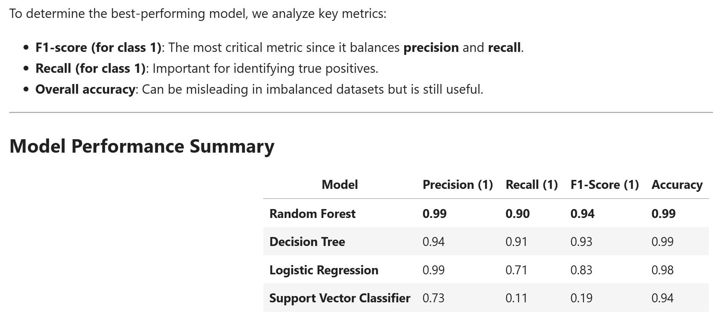
Model Performance Evaluation

Slide 13
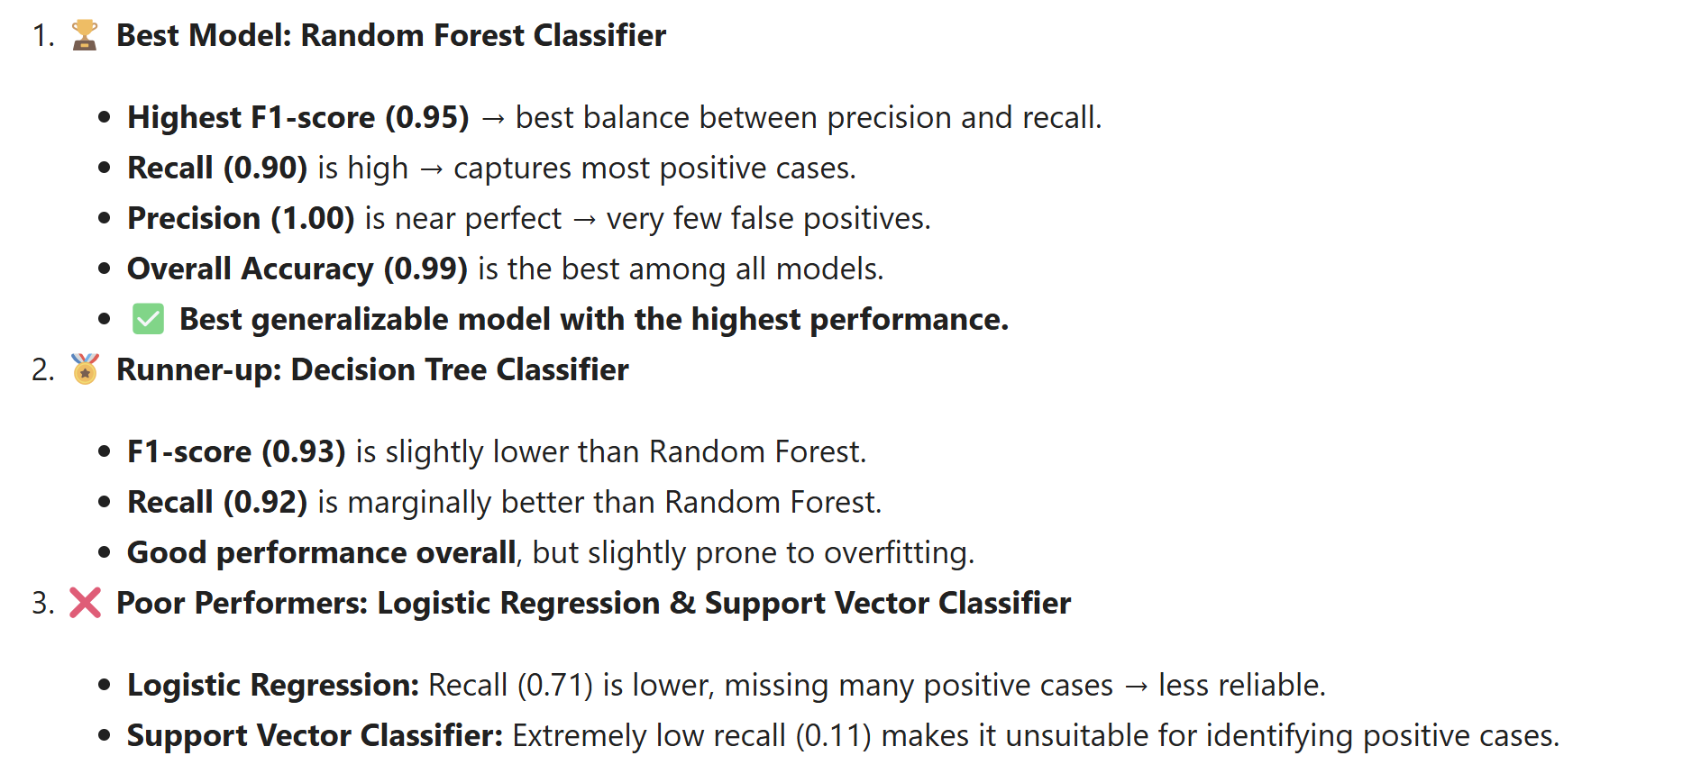
Model Interpretations and Insights.

Slide 14
Final Conclusion.
✅ The Random Forest Classifier is the best model with the highest
F1-score (0.95), recall (0.90), and precision (1.00).
🚀 Decision Tree is also a good alternative but may overfit.
❌Avoid Logistic Regression and Support Vector Classifier due to poor recall scores.

Slide 15
Questions ?

Slide 16
Thank You!

